Slide 1

Waterfall Chart Step by Step Instruction
MIS 561 – Data Visualization

Slide 2
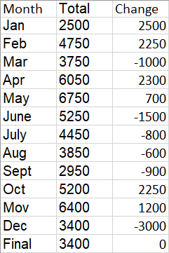
1. Open the attached base file
The Basefile should contain a list of values.
Numeric values on the Sales Flow column may be modified as needed.
Assume that the Total balance starts from 0

Slide 3
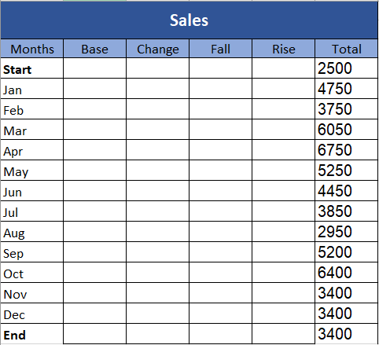
2. Add Base, Fall and Rise column
Re-organize column as needed. The left-hand screenshot has been re-organized with Total column being on the very right side.
Add Base, Change, Fall, Rise column. This would be equivalent to base, decrease and increase on the solution chart.

Slide 4
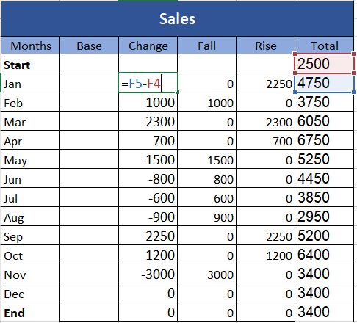
3. Modify the Change Column
By subtracting the Total Value of the previous month (F4) from the current month value (F5), you can calculate the changes.
Double click the right corner of the cell, or drag and drop to populate the fields.

Slide 5
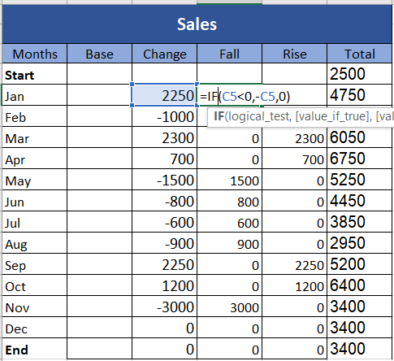
4. Modify the Fall Column
Create a logical if statement to evaluate the values on the change column. If the value is less than 0, then the change should be negative.
Add a negative sign and refer to the cell (e.g., -C5) if it is less than 0
Otherwise, leave it as 0

Slide 6
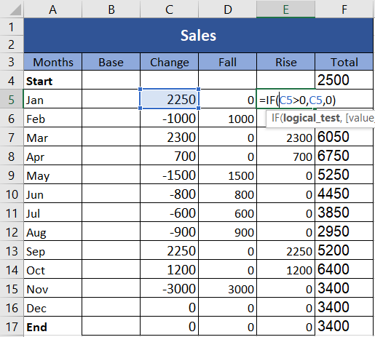
5. Modify the Rise Column
Create a logical if statement to evaluate the values on the change column. If the value is greater than 0, then the change should be positive.
Refer to the cell that is being tested (Change cell itself) if the value is greater than 0
Otherwise, leave it as 0

Slide 7
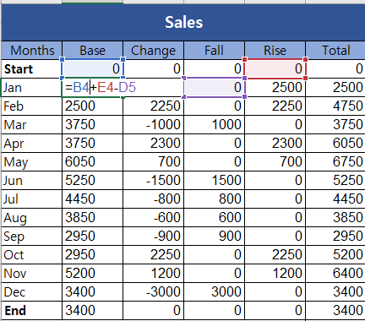
6. Calculate the Base column – a bit tricky
The goal is to fill-in base values so the Base = Total from a previous month + Change for this month
For example, Total for February was 4750, and change for March was -1000. Thus, the base value for March is 3750.

Slide 8
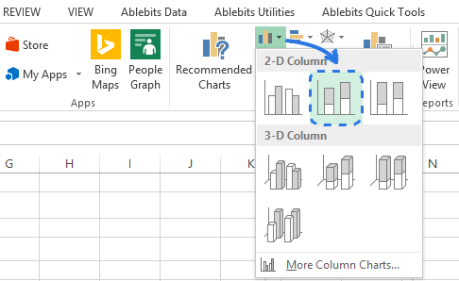
7. Create Standard Stacked Column Chart
Using the data that was generated, create a stacked column chart using the bar chart icon next to the Recommended Charts
Use Months, Base, Fall and Rise as the selected data columns (Make Sure you include the column header)
Include Start and End values as well.

Slide 9
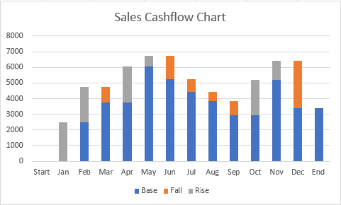
8. Navigate into Format Data Series
The chart that looks similar to the screenshot should have been created.
Right-click on “Base” case, then choose the option “Format Data Series.”

Slide 10
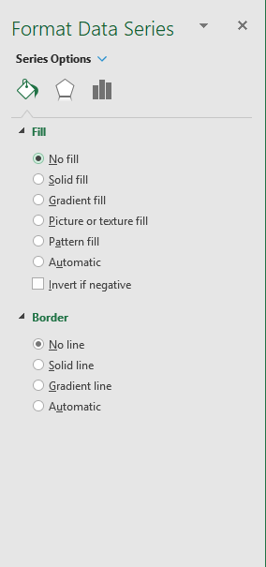
9. Format Data Series
Navigate to Fill & Line section
Expand Fill option
Choose No fill
Expand Border option
Choose No line
Doing this will remove the fill and the outline of the Base cases.

Slide 11
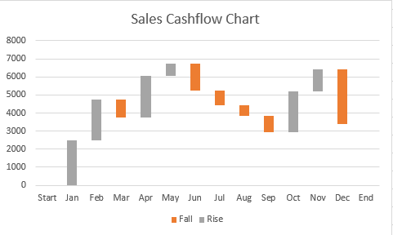
10. Formatting the Resulting Graph
The graph should look very similar to the screenshot on this slide.
Delete the base legend if the bars for base values appear to be removed

Slide 12
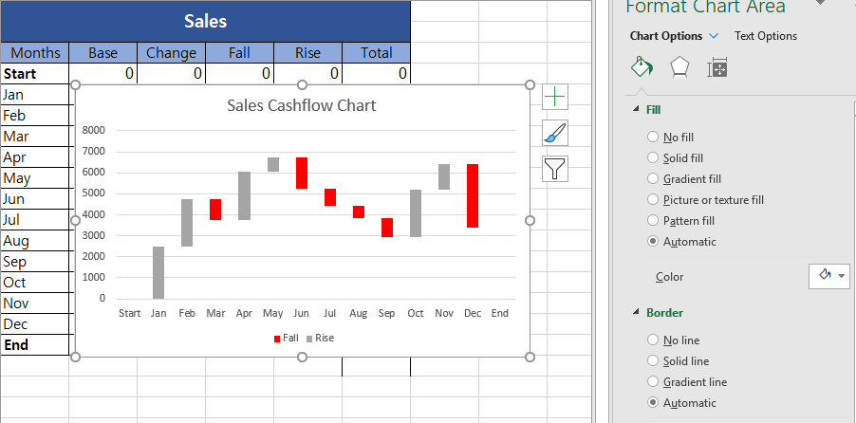
11. Optional Change the colors (series)
Change color as needed (Either Format chart Area or Shape Fill icon may be used)
The base values at either start or end should be changed individually (Resulting graph on the next slide)

Slide 13
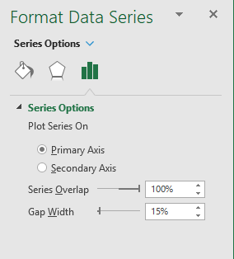
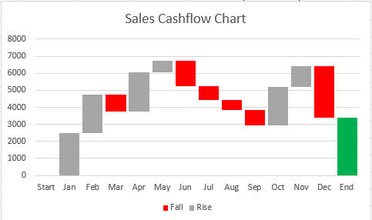
12. Format the Gap Width
On the Format Data Series tap, choose a select series option.
Change the Gap Width to 15%

Slide 14
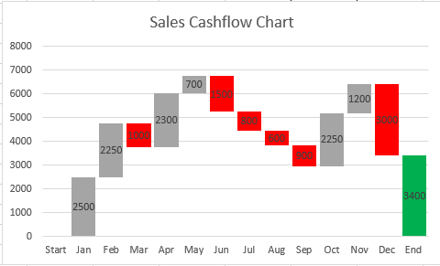
13. Add data label
Right-click any of the bars
Click Add Data Label option
Remove Zeroes and Un-needed values
Repeat for Base, Fall and Rise values
The resulting graph should look like the one on this page.
*Depending on the design of the dataset itself, you may have negative values for the “fall” column.

